Slide 1
DIY Sliders

Slide 2
Objective
After class today you should be able:
Implement your own slider using a CustomPainter.
Finish project 2 (due this week).

Slide 3
Basic architecture for versions of the project.
State
What do you need to know in order to…
Draw things on the screen?
Return values for your widget?
Listener Class
Update the state based on what’s happening.
onPointerDown
onPointerMove
onPointerUp
Don’t forget to call setState(() {…}) to force a redraw
CustomPainter
Draw things on the screen (aka canvas) based on the state.
Circles, lines etc.
API
How does a programmer use your slider?
Initialization
Values.

Slide 4
First step:
Make a circle move to where the finger goes down.
State:
Where the finger when down.
Listener
onPointerDown: update state with finger down location.
(and setState eventually)
CustomPainter
Put the circle where the finger is.
That’s about it for project 1 due at the end of the week.

Slide 5
Next step:
Circle follows the finger.
State
Same as before: where is the finger.
Listener
onPointerDown: same as before.
onPointerMove: update state with finger location.
CustomPainter
Same as before.
So what? The point here is that the architecture decomposed the problem for us and made it easier to think about.

Slide 6
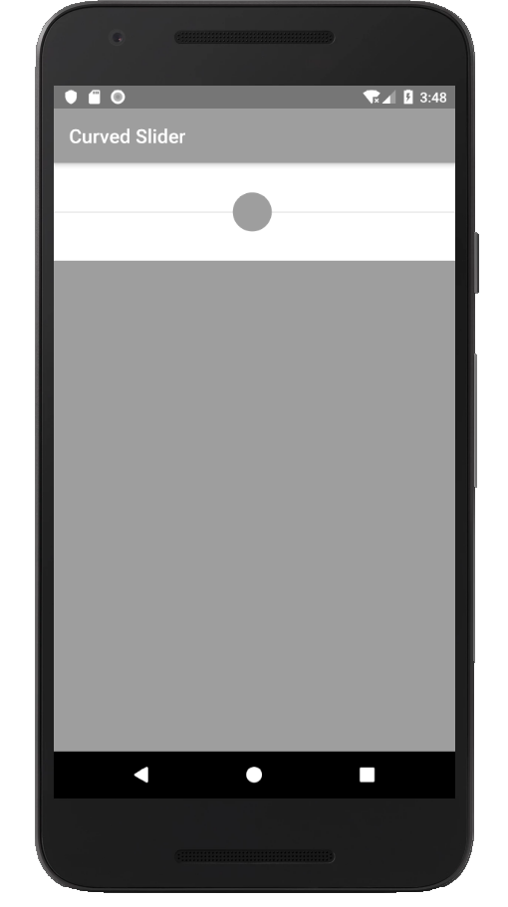
Now for sliders.
What should the behavior of a slider be?
How should it look?
What should we have in the API?
For initialization?
Return values?
In the beginning, let’s just do a simple one thumb vanilla slider.

Slide 7
Vanilla slider version 0.1
State
Where the thumb is located.
Value (0 on the left, 100 on the right). Calculated from thumb position. Need to think carefully about where to update this. Not in CustomPainter. Probably in a method called from Listener
Listener
onPointerDown: did they hit the thumb? Close enough?
onPointerMove: what to do if they slipped off the thumb?
Update thumb position.
CustomPainter
Update thumb position.
Draw the line on which the thumb travels. Drawing a diagram helps get the positions down.
API
A method for getting the slider value.
No events yet.
Pretty close to done for project 2 (Just need a way to display the value as it slides along)

Slide 8
Vanilla slider version 0.1.
How will someone know when the value changes?
We could expose a getSliderValue method.
So they just have to call that repeatedly
This is called “polling”--generally a bad idea for a widget to force polling.
The appearance and functionality are also brittle.
What if someone wants to use the range 0 to 200 instead?
Smaller thumb? Only ½ the screen width?
We’ll deal with getting the value first.

Slide 9
Vanilla slider version 1.0
State:
No changes.
Listener
No changes
CustomPainter
No changes
API
Expose an interface, use the Flutter convention for this. A listener must be passed to the constructor for the slider.

Slide 10
Exposing an interface
Getting the right API is critical.
Most of the time, for vanilla widgets, just follow the convention.
For other situations, be thoughtful, adapt as needed.
In flutter, the convention is to pass a callback in the constructor.
final double value; final ValueChanged<double> onChanged; …
MySlider ({ @required this.value, @required this.onChanged, this.xPosition, this.thumbColor, this.thumbInactiveColor, this.thumbActiveColor, this.radius });

Slide 11
Vanilla Slider version 1.0 wrapup.
This is the version due 1/24/20
Slider constructor takes a callback as a parameter, stores the callback and calls the callback when the value changes.
Slider calls the callback with the new value as a parameter.
The callback updates some state inside setState.
Everything that uses that state is redrawn.
Slider constructor also takes a left and right range.

Slide 12
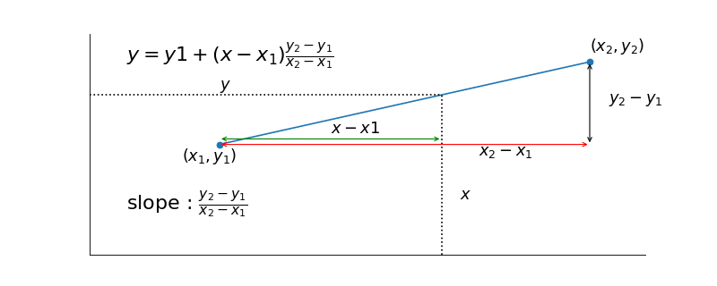

What about linear interpolation?
$y$ is a component of the color. $x$ is just $x$.
Linear interpolation — Tutorials on imaging, computing and mathematics (matthew-brett.github.io)

Slide 13
Exposing an interface—Android Java version
Inside the widget class, declare an interface.
Let’s have just 1 method: onValueChanged.
When the value changes, the seekBar calls this method in the listener.
The listener does whatever it wants.
In the widget, make a “register to listen” method.
In the listener,
implement the interface
Instantiate a widget and then register to listen to that widget.

Slide 14
Reflecting on version 1.0
Pretty complete for next project.
Major ideas for a widget are in place, except generalization (see below)
We won’t go through all the project at this level of detail, but this should get you started.
For project 2,
generalize to n thumbs.
Generalize to a (reasonable) range of values.
Big on right, small on the left.
Generalize to different screen widths.
We’ll talk about this one in some detail.
For project 3, curved slider (but for a specific curve).

Slide 15
Generalizing the slider: thumbs
State
Keep track of multiple thumbs. I like Lists.
onTouchEvent
Which thumb did they hit, if any?
What happens if they slide a thumb past another thumb?
onDraw
Draw all the thumbs.
API
Number of thumbs as a parameter.
Return a list of thumb values rather than a single value
Or some other way of doing this which you dream up.

Slide 16
Generalizing appearance: padding, thumb diameter etc. (not required for project)
State:
All kinds of parameters about size need to be kept.
onTouchEvent.
Nothing.
onDraw
Nothing.
API
Add the parameters.
Maybe include a default constructor with default values.

Slide 17
Curved sliders
State
Interpolate the value of the slider differently. Was just linear interpolation on the x value of the thumb. You can decide how to do this.
CustomPainter
Draw a curve instead of a line. (A bit of a pain to specify, especially since there isn’t a “draw part of an ellipse using this implicit representation” method.)
Don’t forget to mind screen space and ellipse space issues.
Listener
In OnPointerMove, calculate the new thumb position differently. (not difficult to code up once you know what to code up).
Initial finger press on the thumb is about the same.
API
No change.

Slide 18
Drawing an arc (in flutter)
Slightly painful, but not that painful. See
https://api.flutter.dev/flutter/dart-ui/Canvas/drawArc.html

Slide 19
Where is the thumb on the arc?
Thumb on slider path
Finger location
Arbitrary pivot point
This can be a ray tracing problem, see
https://www.dropbox.com/s/x0w5t5w0sjerg5p/Curved%20slider.pdf?dl=0

Slide 20
Notes from our multi-day discussion in class
See https://www.dropbox.com/s/t0vn9esjli80tbz/Curved%20slider%20v2.pdf?dl=0

Slide 21
Programming tips
Have a piece of paper on which you sketch this out.
Don’t forget to normalize your direction vector!
Make sure you can see what your code is doing. If you can’t see it, you can’t debug it.
I draw stuff on the screen for debugging.
Then turn it off when I’m done.
Check you equations in your code.
I found this ellipse viewer handy
https://www.desmos.com/calculator/huko7itjso

